Slide 1
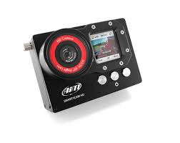
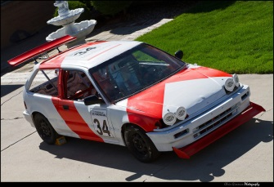
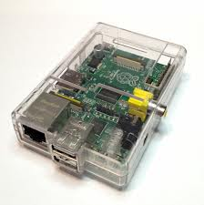
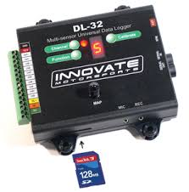
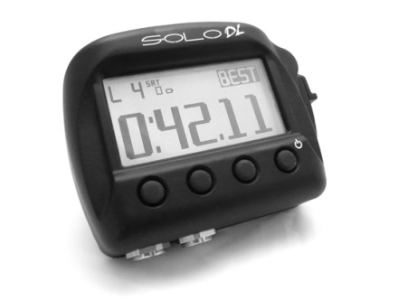
Insert Your Chump Car
SmartyCam HD
The RPI2 (w/Software) allows us to integrate legacy equipment with modern data loggers and performance analysis tools. Ultimately SmartyCam HD shows you RPM, Oil temperature etc, overlaid on your actual race video so you can easily analyze race performance.
DL-32 A/D Logger
AIM Solo DL
Raspberry PI 2 (Model B)

Slide 2
ECU Bridge (Raspberry PI 2)
ecubridge
(daemon)
RS-232
RS-232
UDP
DL-32
Solo DL
TCP
ecudatalogger
(daemon)
rrdtool
(daemon)
The ecubridge daemon is the main controller. It “transcodes” DL-32 raw data to normal data, then transcodes again to format for the SoloDL. At the same time it logs the raw, normal and output data to the ecudatalogger (backed by RRD Tool), and listens for both user commands and USB Bus events. The main event loop is select() based and tracks to a 100ms work cycle (10hz) to align with the AIM Solo DL protocol. The DL-32 has a different data rate, but we just drop the occasional sample; 10hz resolution is more than enough to be reasonably accurate.
Command Port
USB Bus
We must pay attention to the USB Bus because when we power on, the USB cable might not be connected yet, or it may be connected/disconnected while the RPI2 is up and running. We have to be ready to start and or pause as needed.

Slide 3
Virtual Channel (1 .. 15)
DL-32
Transform
Filter
Source
Dest
Filter
Transform
Solo DL
Raw Data
Normal Data
Output Data
Input Transform: convert voltage level to scaled value (i.e. an engine RPM value)
Output Transform - align with AIM protocol
Input Filter – manual override other filtering of input values.
Output Filter – allow for manual override.
Input / output patching, maybe channel 1 input should be wired to channel 2 output, etc.
Once input data has been transformed and filtered, it is now in “normal” format. For example if you expect to see an RPM value of 1200, the same as what the Honda sees on its dashboard…this is where you would see 1200. At the input the value may be encoded as something else (i.e. a 12 bit voltage level), and at output it can be encoded as something else to match the AIM protocol. Its only in the middle where we expect data to be “normal”.

Slide 4
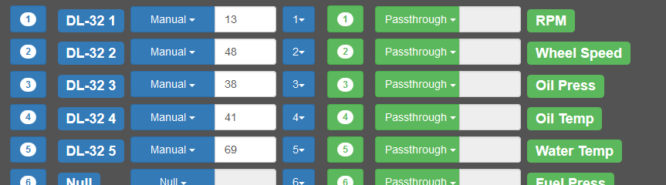
Example Channel Map
In this example all 5 DL-32 channels have been given manual overrides. For example The RPM channel has been pegged at 13. Notice that for Source and Dest, we have 1:1, that is no re-ordering of inputs to outputs. But the pull down for Source could be used to swap (for example) channel 1 input with any other channel input. So you can “hot wire” what DL-32 input is used for the RPM channel in the Solo DL.
Both input and outputs have transformers. For example “DL-32 1” would know how to interpret a 12bit voltage level value to be an appropriate scaled value for the range of RPM values for the Honda. Similarly on the output side “RPM” is a transformer that knows how to align with AIM protocol so that when you have a value of RPM=1200, the Solo DL will actually show 1200. The AIM protocol actually does various transforms for the different channels, presumably to keep them with the range of data types used in the Solo DL.

